Slide 1
SEMANTIC UNDERSTANDING OF AN IMAGE USING MULTI REGION LABEL ANNOTATION
UNDER THE GUIDANCE OF
DR.S.CHITRAKALA
GROUP 10
MOHANA PRIYA K 2013103552
SUDHARSAN S 2013103566
GAYATHRI DEVI K 2013013579

Slide 2
INTRODUCTION
Image processing is a rapidly growing field of research. .
Common people can easily understand the image on seeing the image with their naked eyes but that is not the case with the blind people. The project intends to help such people.
Given an image , the image is converted to textual description of that image which can be given as a input .
The process involved in image to textual description includes image processing like Feature Extraction, Similarity Computation and Object Recognition.
In addition to this, Multi Label Annotation is involved for better understanding of image.

Slide 3
OBJECTIVE
To semantically understand a given image and to come up with the Textual Description for that image.
- To extract feature points from the clipped object in Offline Process and from the input image during the Online Process.
- To compute similarities between the feature points extracted from both the images.
- To recognize objects in the image based on the similarities.
- To label multiple objects in the image. (Multi-Label Image Annotation).
- To determine the Spatial relationship between the labels/objects recognized.
- To come up with a Textual Description about the objects in the image.

Slide 4
LITERATURE SURVEY
BASE PAPER | METHODS | ISSUES
Matthew R. Boutell, Jiebo Luo, Xipeng Shen, and Christopher M. Brown, “Learning multi-label scene classification”. | Region growing method | No accuracy
X. Ding, B. Li, W. Xiong, W. Guo, W. Hu, and B. Wang,“Multi-instance multi-label learning combining hierarchical context and its application to image annotation”. | Multi-label Learning (MIML) | Correlation between the object is not established
Shantanu Godbole and Sunita Sarawagi, “Discriminative methods for multi-labeled classification”. | Support Vector Machine (SVM) | Time consuming
Feng Kang, Rong Jin, and R. Sukthankar, “Correlated label propagation with application to multi-label learning” | Correlated Label Propagation (CLP) | Not efficient while labeling the object

Slide 5
LITERATURE SURVEY
BASE PAPER | METHODS | ISSUES
Guo-Jun Qi, Xian-Sheng Hua, Yong Rui, Jinhui Tang, Tao Mei, and Hong-Jiang Zhang, “Correlative multi-label video annotation” | Correlative Multi-Label (CML) | Performance varies
Jamie Shotton, John Winn, Carsten Rother, and Antonio Criminisi, “Textonboost: Joint appearance, shape and context modeling for multi-class object recognition and segmentation” | Conditional Random Field (CRF) | Segmentation is not accurate.
Zheng-Jun Zha, Xian-Sheng Hua, Tao Mei, Jingdong Wang, Guo-Jun Qi, and Zengfu Wang, “Joint multi-label multi-instance learning for image classification” | MIML-BOOST MIMI-SVM | The connections between instances and labels, and the correlations among labels are not sufficiently leveraged to improve the classification performance.

Slide 6
PROPOSED SYSTEM
To semantically understand a given image and to convert into its Textual Description, by using Multi-Label (ML)Annotation.
The overall system is intended
To achieve multi label annotation to understand the images better and to provide a short description based on the spatial relationship between the objects in an image.

Slide 7
OVERALL ARCHITECTURE DIAGRAM
INPUT
IMAGE
IMAGE CROPPING
FEATURE EXTRACTION
DATABASE
CLIP-ART
POINT FEATURE EXTRACTION
Clip arts from original image
FEATURE
EXTRACTION
INPUT
IMAGE
SIMILARITY
COMPUTATION
POINT FEATURE EXTRACTION
IMAGE ANNOTATION
OBJECT
RECOGNITION
TEXTUAL DESCRIPTION OF THE IMAGE
SPATIAL
RELATIONSHIP DETERMINATION
LABEL 1
MULTI LABEL ANNOTATION
BLOB DETECTOR
LABEL 2
LABEL N

Slide 8
LIST OF MODULES
The list of modules involved in the entire process are as follows:
Image Cropping
Feature Extraction
Similarity Computation
Object Recognition
Multi Label Image Annotation
Spatial Relationship Determination

Slide 9

IMAGE CROPPING: (OFFLINE PROCESS)
Cropping refers to the removal of the outer parts of an image to improve framing, accentuate subject matter or change aspect ratio.
A set of images which needs to be trained is cropped using Crop image Interactive Tool.
Open Crop Image tool associated with this image.
Specify a variable in which to store the cropped image.
The input to this module is the Original Image and the output is the Cropped Object from it.

Slide 10


IMAGE CROPPING (OFFLINE PROCESS)
INPUT:
OUTPUT:

Slide 11

FEATURE EXTRACTION: SURF FEATURES (SPEEDED UP ROBUST FEATURES) ALGORITHM
The Original image is given as input to feature extraction.
In this module feature are extracted using SURF (Speeded Up Robust Features) method which include point features.
The input to this module is the Input Image and the output is the Feature Points extracted from the image.
where,
F(I) gives the Current Filter size of the image.
F(Scale) gives the Base Filter Scale of the image.
F(Size) gives the Base Filter Size of the Image.

Slide 12
FEATURE EXTRACTION: SURF FEATURES(SPEEDED UP ROBUST FEATURES) ALGORITHM
INPUT:
Image in which all possible feature points are detected.
OUTPUT:
All feature points in the image.
ALGORITHM:
Begin
boxPoints = detectSURFFeatures(boxImage); %extract features of cropped image
scenePoints = detectSURFFeatures(sceneImage); %extract features of original image
End
IMAGES OR OBJECTS
INPUT
FEATURE EXTRACTION
OUTPUT
POINT FEATURE

Slide 13
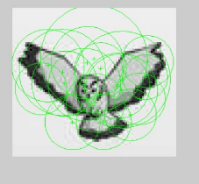
FEATURE EXTRACTION: (OFFLINE PROCESS)
INPUT:
OUTPUT:

Slide 14
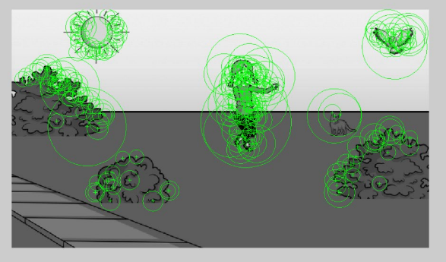
FEATURE EXTRACTION: (ONLINE PROCESS)
INPUT
OUTPUT

Slide 15

SIMILARITY COMPUTATION: (ONLINE PROCESS)
Feature extracted from image is computed for similarity to features extracted from object which are stored in the database.
The input to this module are two images: Feature Extracted Original Image and the Feature Extracted Cropped objects stored in the database.
The Euclidean Distance metric is used to compute the similarity between the features of clipped object and original image.
Where,
d(x,y) is the distance between the co-ordinates of both the axes of the objects.

Slide 16
SIMILARITY COMPUTATION: (ONLINE PROCESS)
INPUT:
Extracted feature from object and input image is computed.
OUTPUT:
Similar image are displayed.
ALGORITHM:
Begin
boxPairs = matchFeatures(boxFeatures, sceneFeatures);
matchedBoxPoints = boxPoints(boxPairs(:, 1), :);
matchedScenePoints = scenePoints(boxPairs(:, 2), :);
showMatchedFeatures(boxImage, sceneImage, matchedBoxPoints, ... matchedScenePoints, 'montage');
End
FEATURE EXTRACTED IMAGES AND OBJECTS
INPUT
SIMILARITY COMPUTATION
OUTPUT
SIMILARITY BETWEEN IMAGES AND OBJECTS

Slide 17
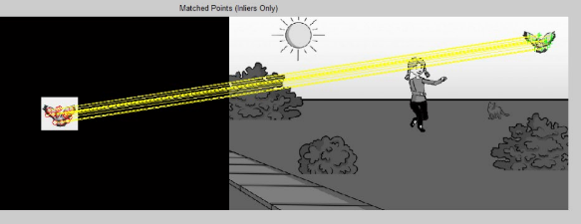
SIMILARITY COMPUTATION: (ONLINE PROCESS)

Slide 18

OBJECT RECOGNITION (ONLINE PROCESS)
Object is recognized in image using clustering and Blob Detector method, if feature matches between the object and image.
The input to this module is the region where there are similar feature points identified in the Similarity Computation Module and the output is shown as rectangle box drawn in the image where the object is recognized.
Finally, the objects are located in the scene using matched points.
where
(x,y) is the point co-ordinate values of x and y axes of the objects.
t is the scale to which blobs have to be detected.

Slide 19
OBJECT RECOGNITION: (ONLINE PROCESS)
INPUT:
The input to the module is the image in which all feature points are extracted .
OUTPUT:
All possible objects are recognized in the image.
ALGORITHM:
Begin
matchedBoxPoints = boxPoints(boxPairs(:, 1), :);
matchedScenePoints = scenePoints(boxPairs(:, 2), :);
boxPolygon = [1, 1;... % top-left
size(boxImage, 2), 1;... % top-right
size(boxImage, 2), size(boxImage, 1);... % bottom-right
1, size(boxImage, 1);... % bottom-left
1, 1];
newBoxPolygon = transformPointsForward(tform, boxPolygon);
line(newBoxPolygon(:, 1), newBoxPolygon(:, 2), 'Color', 'y');
End
SIMILARITY COMPUTED IMAGE
INPUT
OBJECT RECOGINITION
OUTPUT
OBJECTS RECOGNIZED IN IMAGE

Slide 20
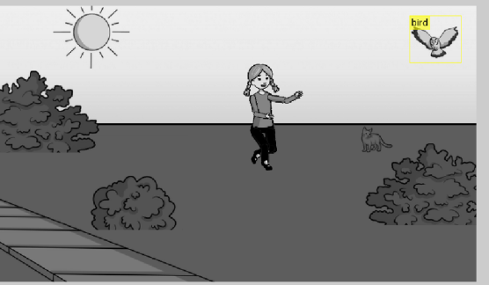
OBJECT RECOGNITION: (ONLINE PROCESS)
INPUT:
OUTPUT:

Slide 21
MULTI LABEL IMAGE ANNOTATION: (ONLINE PROCESS)
The objects which are recognized in the previous stage are labelled using multi label annotation.
The input to this module are the objects recognized and the output is shown as multi-label, annotated in the given image for objects which are matched from the database.

Slide 22
MULTI LABEL IMAGE ANNOTATION: (ONLINE PROCESS)
INPUT:
Image in which the objects are identified.
OUTPUT:
Object in the image are labelled.
ALGORITHM:
Begin
position = [newBoxPolygon(5, 1), newBoxPolygon(4, 2)];
Rgb=insertText(sceneImage,position,filenames(n).name);
imshow(Rgb);
End
OBEJECT RECOGINIZED IMAGE
INPUT
MULTI LABEL IMAGE ANNOTATION
OUTPUT
OBJECTS ARE LABELED IN IMAGE

Slide 23
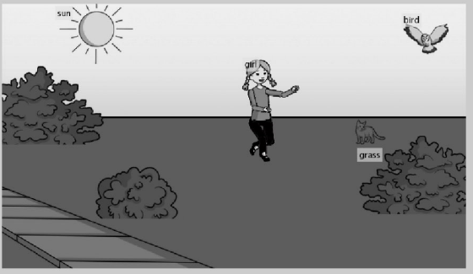
MULTI LABEL IMAGE ANNOTATION: (ONLINE PROCESS)
INPUT:
OUTPUT:

Slide 24
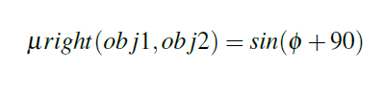
SPATIAL RELATIONSHIP DETERMINATION: (ONLINE PROCESS)
Spatial relationship is found between the objects in the given image which include location of the particular object in that image.
The input to the module is the image in which all possible objects are labelled and the output will be textual description of the object in the image based on their spatial relationship.
The Spatial relationships that are looked into in this system mainly come under the Directional Relations namely Left, Right, Top and Bottom.
where,
µ is the angle of straight lines between the centres of the two objects.

Slide 25
SPATIAL RELATIONSHIP DETERMINATION: (ONLINE PROCESS)
INPUT:
Image in which the objects are labelled.
OUTPUT:
Textual description of the image.
ALGORITHM:
Begin
if(A(n,1)>A(a,1))
if(isempty(B{n}) || isempty(B{a}))
continue
else
S=sprintf('%s is to the right of %s',B{n},B{a}); %same for left, top and bottom.
disp(S);
End
End
MULTI LABELED IMAGE
INPUT
SPATIAL RELATIONSHIP DEERMINATION
OUTPUT
TEXTUAL DESCRIPTION OF THE IMAGE

Slide 26
SPATIAL RELATIONSHIP DETERMINATION: (ONLINE PROCESS)
INPUT:
OUTPUT:
Girl is to the bottom of the Sun.
Girl is to the left of the Grass.
Girl is to the bottom of the Bird.
Bird is to the right of the Sun.
Bird is to the top of the Grass.

Slide 27
TEST CASES
POSITIVE CASES (POSE VARIANTS)
It work for all objects irrespective of their pose, provided that the feature points match.
NEGATIVE CASES
In some cases, the desired output is not got because of comparitively lesser size of the images or the missing enough feature points to identify an object.

Slide 28
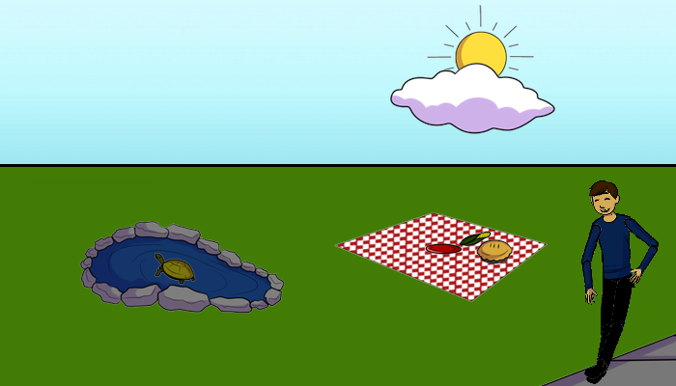
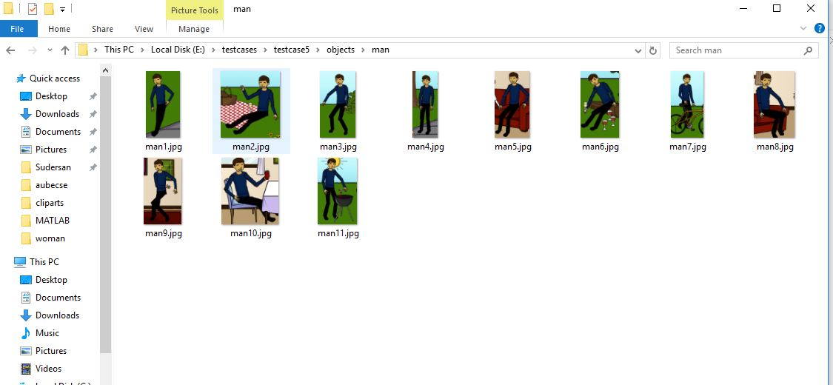

POSITIVE CASES (POSE VARIANTS)
INPUT: (IMAGES) INPUT: (CLIP ART)

Slide 29
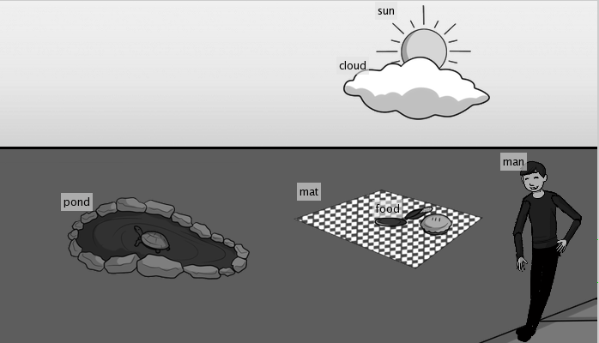
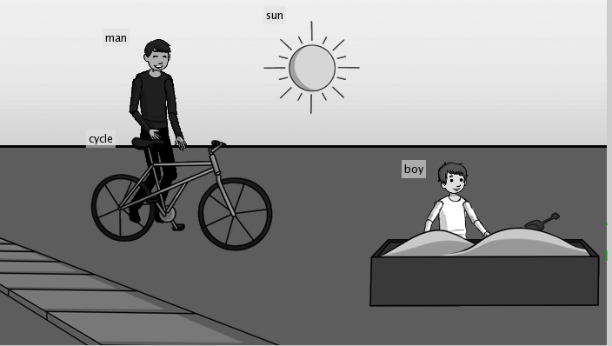
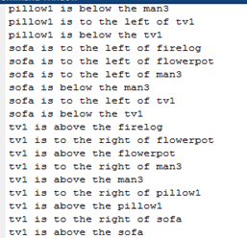
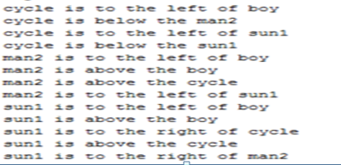
POSITIVE CASES (POSE VARIANTS)
OUTPUT: (MULTI LABEL)
OUTPUT: ( TEXTUAL DESCRIPTION)

Slide 30
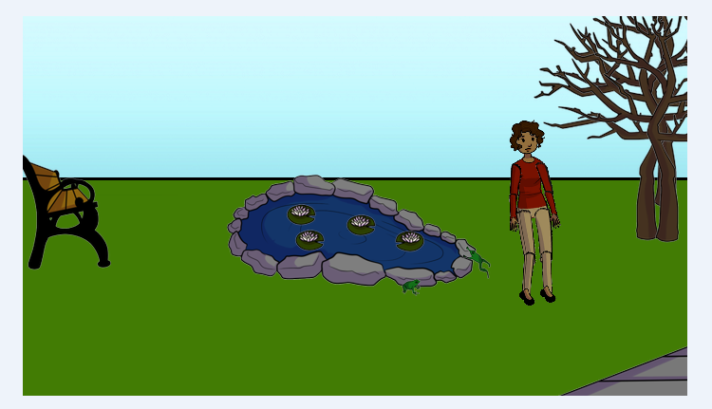
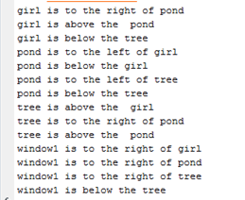
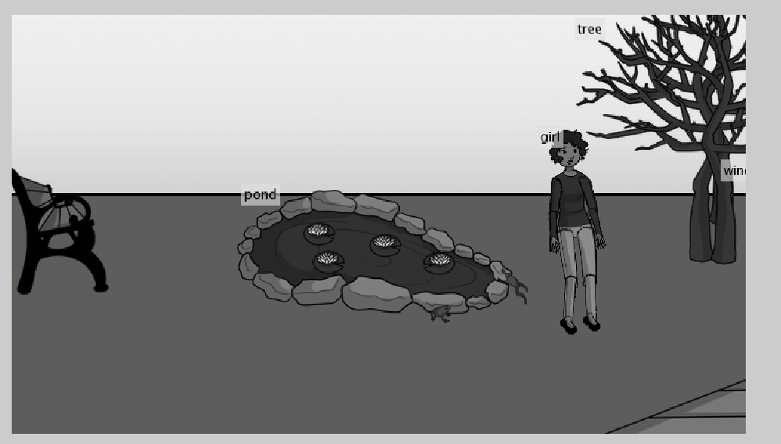
NEGATIVE CASES
INPUT: (IMAGES)
OUTPUT: (MULTI LABEL)
OUTPUT: (TEXTUAL DESCRIPTION)

Slide 31
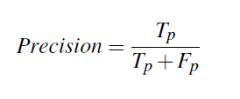


PERFORMANCE METRICS
Precision
Precision (also called positive predictive value) is the fraction of retrieved textual description that are relevant.
Recall
Recall (also known as sensitivity) is the fraction of relevant textual description that are retrieved.
F-score or Accuracy
The accuracy is the proportion of true results (both true positives
and true negatives) among the total number of cases examined.
Accuracy =

Slide 32
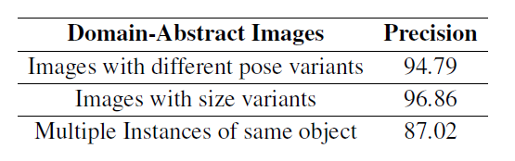
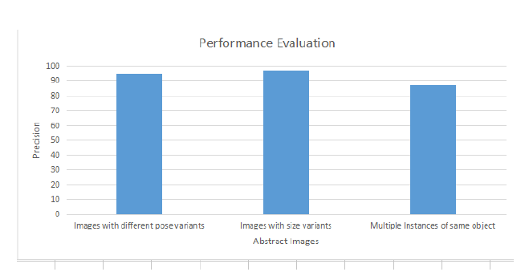
PRECISION

Slide 33
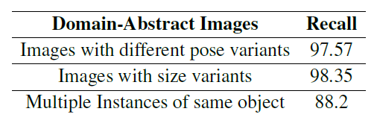
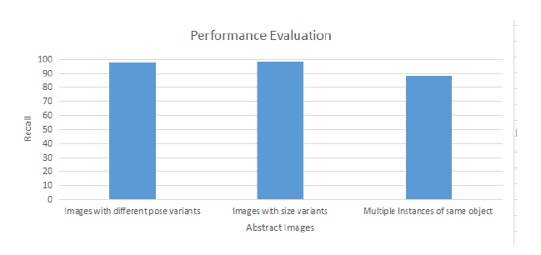
RECALL

Slide 34
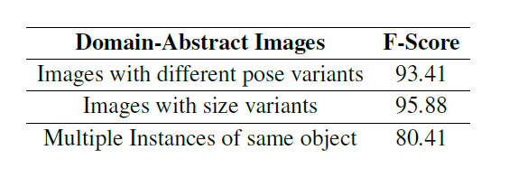
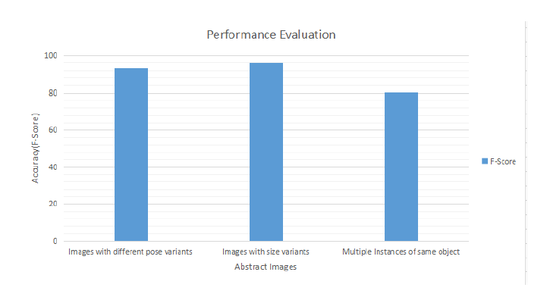
F-SCORE

Slide 35
RESULTS
Based on the Performance Evaluation of the entire system, it is observed that the system works even for different pose variants.
It may fail in some cases where the cropped object size is very small.
The system also captures for such objects in which there is multiple instances of the same object.
The Accuracy of the overall system is found out to be 89.9%.

Slide 36
CONCLUSION
Multi-Label Image Annotation, in which almost all the objects in the image are found and labelled.
Then the spatial relationship that exists between the objects in the image are taken into consideration to provide the final output, which is a short textual description about the relationship between the objects in the image.
This can also be used as an input to Hardware system such as Braille through which they can understand the images.
This project help for visually impaired people to semantically understand the image.
Time efficiency can be improved.

Slide 37
REFERENCES
Matthew R. Boutell, Jiebo Luo, Xipeng Shen, and Christopher M. Brown, “Learning multi-label scene classification”, 2004.
X. Ding, B. Li, W. Xiong, W. Guo, W. Hu, and B. Wang,“Multi-instance multi-label learning combining hierarchical context and its application to image annotation”, IEEE Transactions on Multimedia, vol. 18, num. 8, pp. 1616–1627, Aug 2016.
Shantanu Godbole and Sunita Sarawagi, “Discriminative methods for multi-labeled classification”, In In Proceedings of the 8th Pacific-Asia Conference on Knowledge Discovery and Data Mining, pp. 22–30. Springer, 2004.
Feng Kang, Rong Jin, and R. Sukthankar, “Correlated label propagation with application to multi-label learning”, In 2006 IEEE Computer Society Conference on Computer Vision and Pattern Recognition (CVPR’06), volume 2, pp. 1719–1726, 2006.
Guo-Jun Qi, Xian-Sheng Hua, Yong Rui, Jinhui Tang, Tao Mei, and Hong-Jiang Zhang, “Correlative multi-label video annotation”, In Proceedings of the 15th ACM international conference on Multimedia, pp. 17–26. ACM, 2007.
Jamie Shotton, John Winn, Carsten Rother, and Antonio Criminisi, “Textonboost: Joint appearance, shape and context modeling for multi-class object recognition and segmentation”, 2006.
Zheng-Jun Zha, Xian-Sheng Hua, Tao Mei, Jingdong Wang, Guo-Jun Qi, and Zengfu Wang, “Joint multi-label multi-instance learning for image classification”, In 2008 IEEE Conference on Computer Vision and Pattern Recognition, pp. 1–8, June 2008.

Slide 38
THANK YOU

